Slide 1
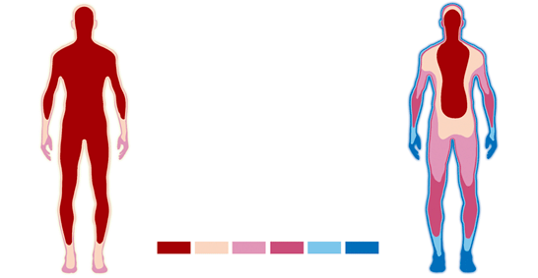
Homeostasis
Regulation of body temperature

Slide 2
Heat production
Cellular respiration – produces heat
Metabolic rate
Rate at which energy is released by the breakdown of food
Exercise increases metabolic rate
Stress also increases metabolic rate as it stimulates the sympathetic division of the nervous system

Slide 3
Heat transfer – gaining & losing heat
Radiation – no direct contact with the heat source. For example warming up by standing in sunlight.
Convection – when hot or cold air passes over the body. For example standing in front of a fan results in heat loss.
Conduction – when heat moves from a warmer object to a cooler object. The objects must come in contact with one another. For example standing on hot sand resulting in getting very hot feet.

Slide 4
Evaporation – cooling effect
Evaporation is the transformation of water from its liquid state to its gaseous state (i.e. steam or water vapour).
The evaporation of sweat results in heat loss → cools the body down

Slide 5
Thermoreceptors
Peripheral receptors: found in the skin and mucous membranes
  Cold receptors
  Heat receptors
Central thermoreceptors: hypothalamus
  Spinal cord and abdominal regions - connected back to the hypothalamus
  The hypothalamus receives information from the peripheral receptors

Slide 6
Behavioural Responses
In cold conditions:
Putting on a jumper, sheltering from the wind, curling into a ball
In hot conditions:
Removing clothing, turning on a fan, spreading out (increasing surface area)

Slide 7
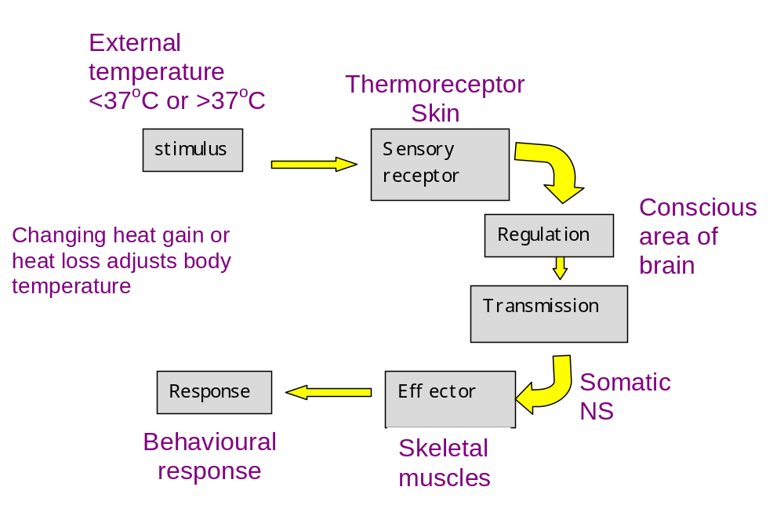
Behavioural Responses

Slide 8
Physiological Responses
In cold conditions:
Vasoconstriction
Shivering
Piloerection
Secretion of adrenaline and noradrenaline
Increase in thyroxine production
In hot conditions:
Vasodilation
Sweating

Slide 9
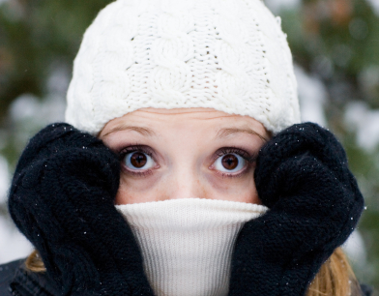
Response to low temperature

Slide 10
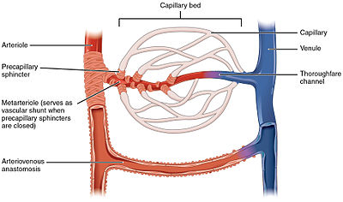
Vasoconstriction
Vasoconstriction
Contraction of the smooth muscle squeezes the arteriole and reduces blood flow to the skin
At the same time, pre-capillary sphincter muscles contract and stop blood flow into the cutaneous capillary beds. Less heat is lost from the surface of the body

Slide 11
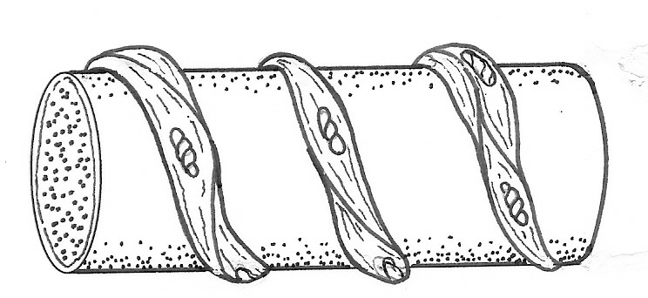
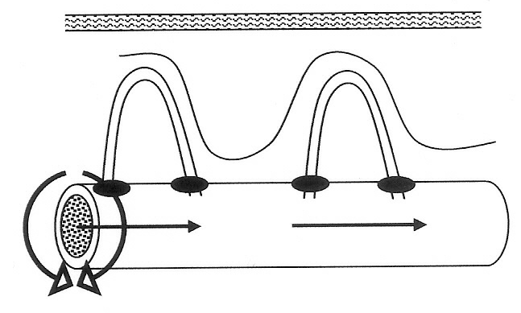
Vasoconstriction
Arteriole
Bands of smooth muscle
Sphincter muscles close
Vasoconstriction

Slide 12
Adrenaline and noradrenaline
The hypothalamus will stimulate the the adrenal medulla (sympathetic NS)
This causes the release of adrenaline and noradrenaline.
One of their many effects is an increase in cell metabolism
  Increase rate of cellular respiration
  Resulting in heat production
  Increase in body temperature

Slide 13
Shivering
The hypothalamus send stimuli to the part of the brain that controls skeletal muscle tone.
Oscillating, rhythmic muscle tremors occur at a rate of about 10 or 20 per second
This increase in movement produces more metabolic heat, thereby increasing the temperature of the core.
Primary control – hypothalamus
Conscious input from cerebral cortex can suppress urge to shiver

Slide 14
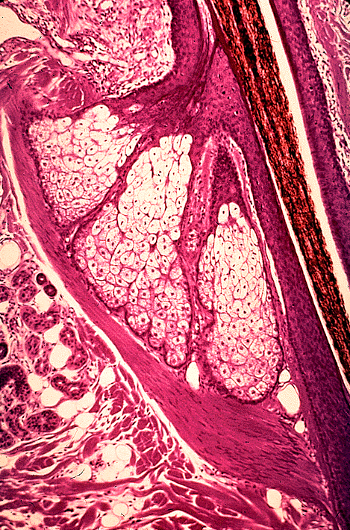
Piloerection
Hair shaft
When the arrector pili muscles contract the hair stands on end (piloerection) and gives us goose bumps.
Piloerection increase the thickness of dead air over the skin and reduces heat loss.
Because humans are not very hairy this is not a very effective mechanism.
Arrector pili muscle

Slide 15
Thyroxine – long term
Hypothalamus causes the anterior lobe of the pituitary to release increased amount of TSH (thyroid stimulating hormone)
The thyroid produces more thyroxine which in turn increases metabolic rate. This increase in metabolic rate produces more heat.
This response is slower to have an effect but is longer lasting. It is a change made by the body each year as the temperature drops heading toward winter.

Slide 16
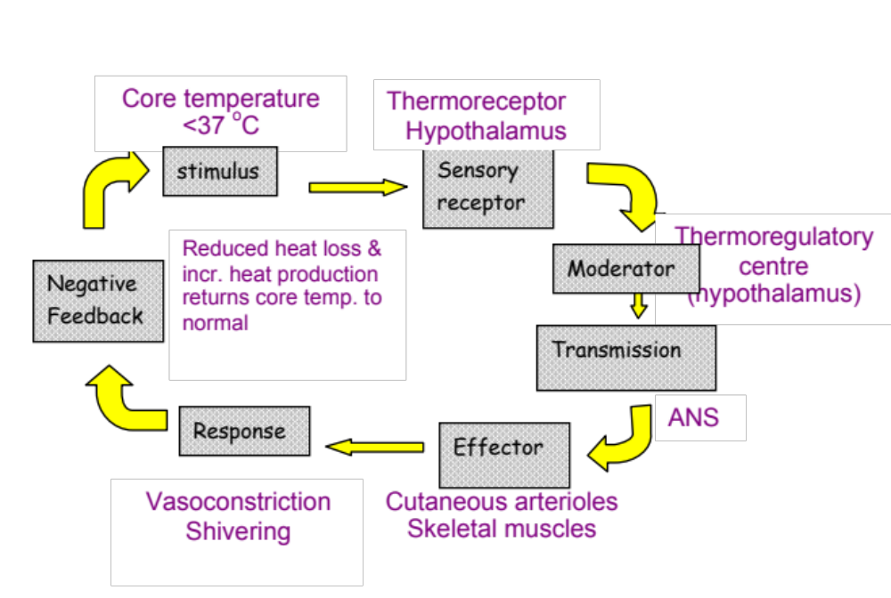
Response to low core temperature

Slide 17
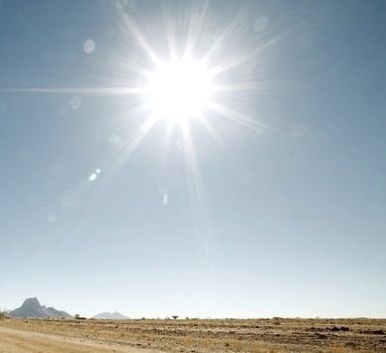
Response to high temperature

Slide 18
Vasodilation
Vasodilation:
  increase blood flow to the skin
  This results in greater heat loss via radiation and convection
  Opposite to vasoconstriction

Slide 19
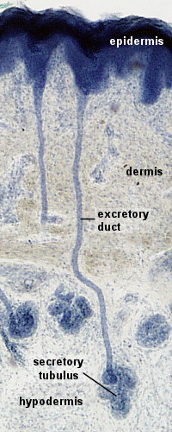
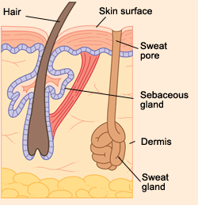
Sweating
Sweat glands
  Secrete sweat
  Carried by the sweat duct to surface of the skin
  Heat loss due to evaporation

Slide 20
Sweat secretion is controlled by the autonomic system.
Which nerves stimulate the production and transport of sweat of the skin surface?

Slide 21
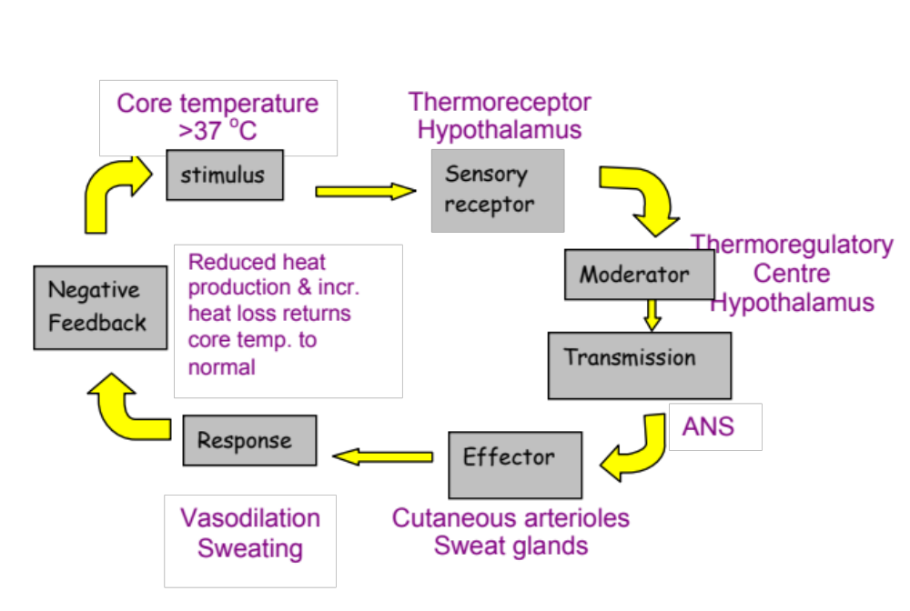
Response to high core temperature

